Slide 1


WELCOME TO
IMI SALES ACCREDITATION
MODULES 3 & 4
Fatma Alsagaf – Learning & Development Manager

Slide 2











HOUSEKEEPING
Notes:
Housekeeping Items for trainer to share with the group.
Timings – 09:30-16:00
Toilets – AATC toilet location based on training room
Fire Exit – Highlight Location and fire assembly point
No Smoking Building – Highlight smoking area
Refreshments to be provided (Canteen area)
Lunch to be provided (Canteen area)
Questions – We encourage and welcome questions to get the most from the course
Mobile Phones/Devices – Are to be switched on silent/off and stored in your bags or pockets to avoid distraction.

Slide 3

YOUR SALES GROWTH JOURNEY – NEXT STEPS...
First Gear - Sales Induction & Probation
IMI Sales Process Module 1 & 2
IMI Sales Process Module 3 & 4
Product eLearning
IMI Sales Process Module 5 (Half day)
On the job training
Advanced Customer Communications
Coaching 1-2-1’s
IMI Sales Accreditation Assessment (In-Branch)
IMI Sales Accreditation Awards Ceremony

Slide 4
AGENDA
Product Presentation SPECIT
Exceptional Test Drive
Objection Handling
The Art of Negotiation
Closing Techniques
My Future Development
Course Close

Slide 5
COURSE AIMS & OBJECTIVES
What are your course objectives?
What are our course objectives
The importance of the presentation and demonstration step for the sales process
How to present the vehicle to a customer using the SPECIT & FFBA techniques
How to perform and exceptional test drive and maximize emotional product connectivity
Define Objections, when they appear during the sales process and techniques handle objectives
Define Negotiation, its challenges and techniques to successfully negotiate with our customers
Define Closing and identify different closing styles to improve confidence and closing ratios

Slide 6

1
SECTION
INTRODUCTION TO PRESENTATION
& DEMONSTRATION

Slide 7
IMODULE 1 & 2 RECAP
WHAT DID WE COVER IN THE LAST SESSION?
Prospecting & Welcome
Negotiation & Closing
Great Deliveries
Follow Up & Retention
Qualification
Presentation & Demonstration
Sales process overview
Lead generation & management
Quality communication
Meet & greet
Building rapport
Questioning
Listening

Slide 8
INTRODUCTION TO PRESENTATION & DEMONSTRATION
Prospecting & Welcome
Presentation & Demonstration
Negotiation & Closing
Great Deliveries
Follow Up & Retention
Qualification
WHERE WE ARE IN THE SALES PROCESS?
At this stage, the sales consultant has just finished gathering all the possible information about the customer
Customer profiling has been done
Matching the customer needs to the product has been finished
Now it is the time to present the product to the customer

Slide 9
WHAT IS THE AIM OF PRESENTATION & DEMONSTRATION?
Stress brand values
Provide complete information about the model that has captured the customer’s interest
Highlight key features of the car that the customer is most interested in during the sales presentation and test drive
Draw the customer’s attention to not so well known and publicized aspects of the car (e.g. options and accessories)
Evoke emotions in the customer that stimulate them to buy
Prospecting & Welcome
Qualification
Presentation & Demonstration
Negotiation & Closing
Great Deliveries
Follow Up & Retention

Slide 10



ACTIVITY: THE DO’s & THE DON’T’s
Using sticky notes place a list of actions that we should do or should not do on the activity board and present back to the rest of the group
2 Groups
10 minutes activity – 5 minutes presentations
Notes:
Groups of three

Slide 11
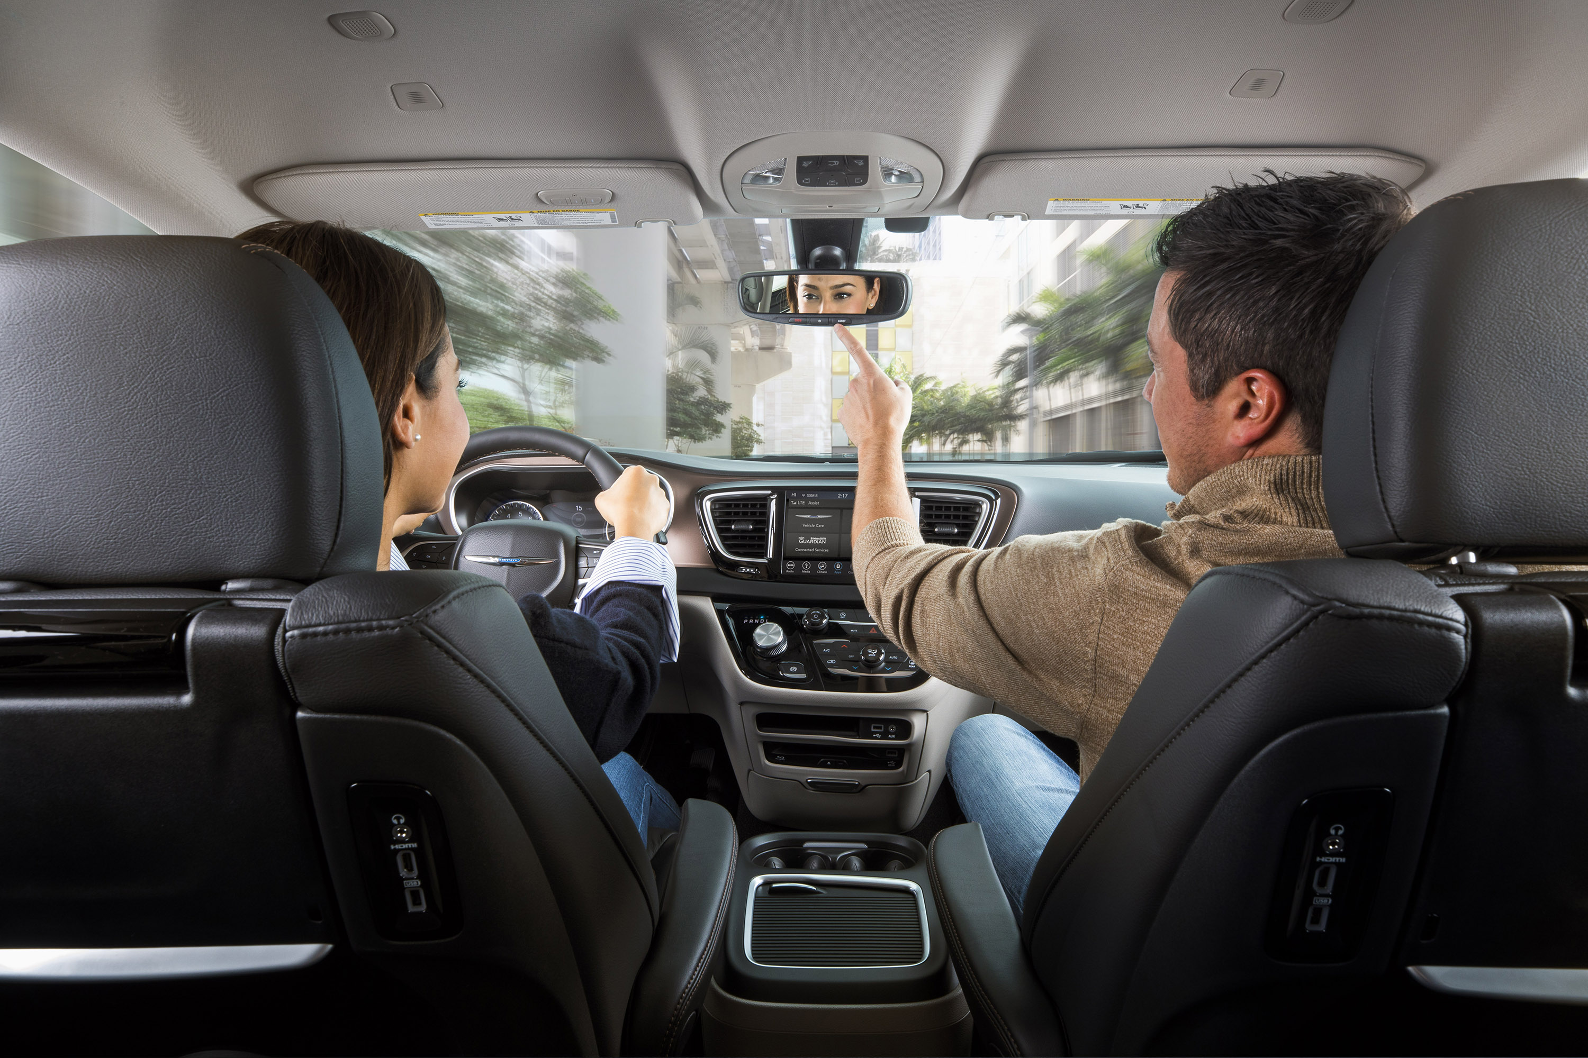
INTRODUCTION TO PRESENTATION & DEMONSTRATION
PRESENT & DEMO STEPS
Tailored Product Presentation
Match vehicle for presentation to customer wants/needs
Personalize vehicle feature/benefit presentation to highlight customer-buying motives
Involve customer in vehicle presentation
Address customer questions
Vehicle
Test Drive
Re-confirm vehicle selection

Slide 12
INTRODUCTION TO PRESENTATION & DEMONSTRATION
PRESENT & DEMO STEPS
Tailored Product Presentation
Offer all customers a test drive
Tailor test-drive route based on customer driving habits
Prepare vehicle for customer drive (e.g., seat, mirrors, fuel)
Address customer questions
Vehicle
Test Drive
Re-confirm vehicle selection

Slide 13
INTRODUCTION TO PRESENT & DEMO
PRESENT & DEMO STEPS
Tailored Product Presentation
Summarize customer drive experience
Highlight key features on vehicle selected
Confirm vehicle selected and/or make alternate recommendation
Explain next steps in the purchase process
Vehicle
Test Drive
Re-confirm vehicle selection

Slide 14
2
SECTION
PRODUCT PRESENTATION

Slide 15
PRODUCT PRESENTATION – Answer the following three questions
How to know your customer’s needs?
Use all the gathered information during the previous steps in the sales process (Lead Management, Matching needs to product)
Complete all available product training
Make a commitment to continual study and practice
Other manufacturers’ websites
Third-party consumer websites
Automotive enthusiast publications and websites
Newspaper or magazine automotive reviews
How do you get to know your product and the competitors?
How can you develop interactive, confident presentation skills?
Use the SPECIT & FFBA methods to support your presentation

Slide 16

PRODUCT PRESENTATION
Remember
The product presentation must TAILORED for each customer, select which features to present based on customer needs and buying motives.
THERE IS NO ONE SIZE FITS ALL!

Slide 17
3
SECTION
SPECIT & FFBA

Slide 18








WHY DO PEOPLE BUY CARS?
SPECIT

Slide 19
PRODUCT PRESENTATION
S
Safety & Security
P
Performance
E
Economy, Environment, Electrification
SPECIT
C
Comfort & Convenience
I
Image
T
Technology

Slide 20
ACTIVITY: SPECIT PRODUCT DISCOVERY
Using sticky notes write a list of features that are connected to the category stated on your SPECIT board provided by the trainer. Try and fill your board with relevant features
Pairs
10 minutes activity – 5 minutes presentations
Notes:
Groups of three

Slide 21
WHAT ARE THE WALKAROUND STEPS?

Slide 22
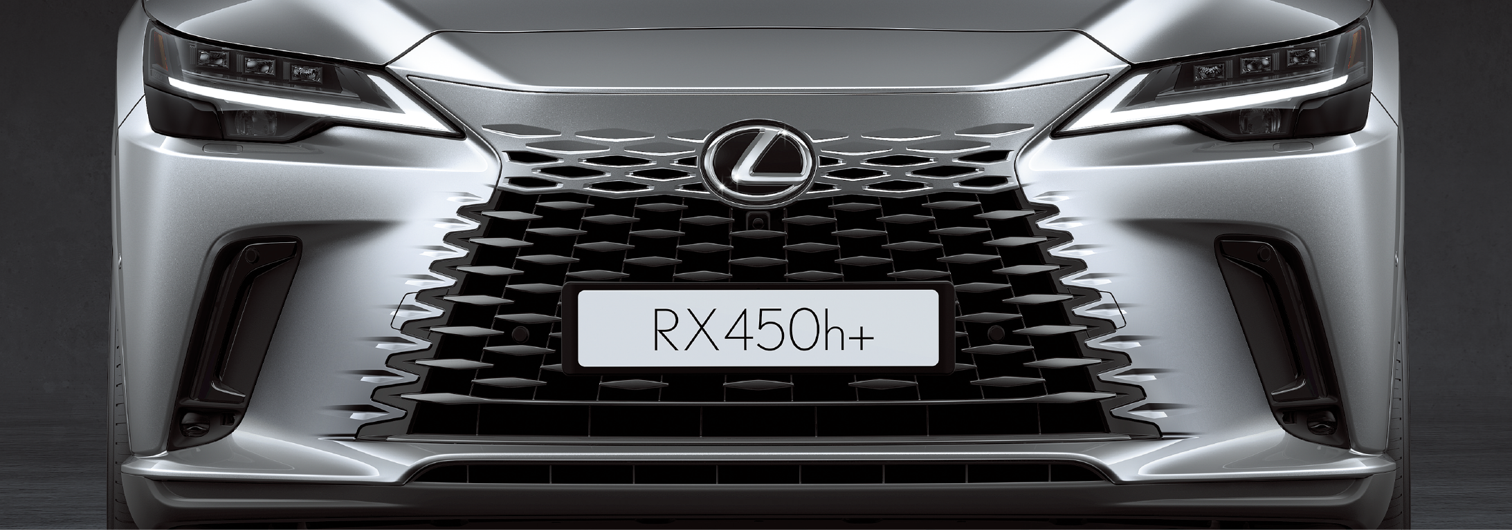
PRODUCT PRESENTATION
WHAT IS THE 5-POSITIONS WALKAROUND PRESENTATION?
Position 1 – Front of the vehicle
Opening statement
Front Styling / Aerodynamics
Lighting
Engines
Transmissions
Other features relevant to this customer’s SPECIT motivations

Slide 23
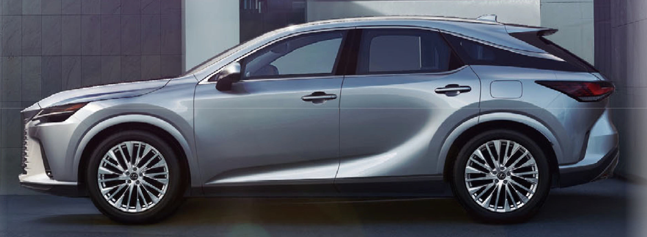
PRODUCT PRESENTATION
WHAT IS THE 5-POSITIONS WALKAROUND PRESENTATION?
Position 2 – Passenger’s Side
Side Styling
Suspension and wheels
Wheels and tires
Brakes
Suspension
Drivetrain

Slide 24
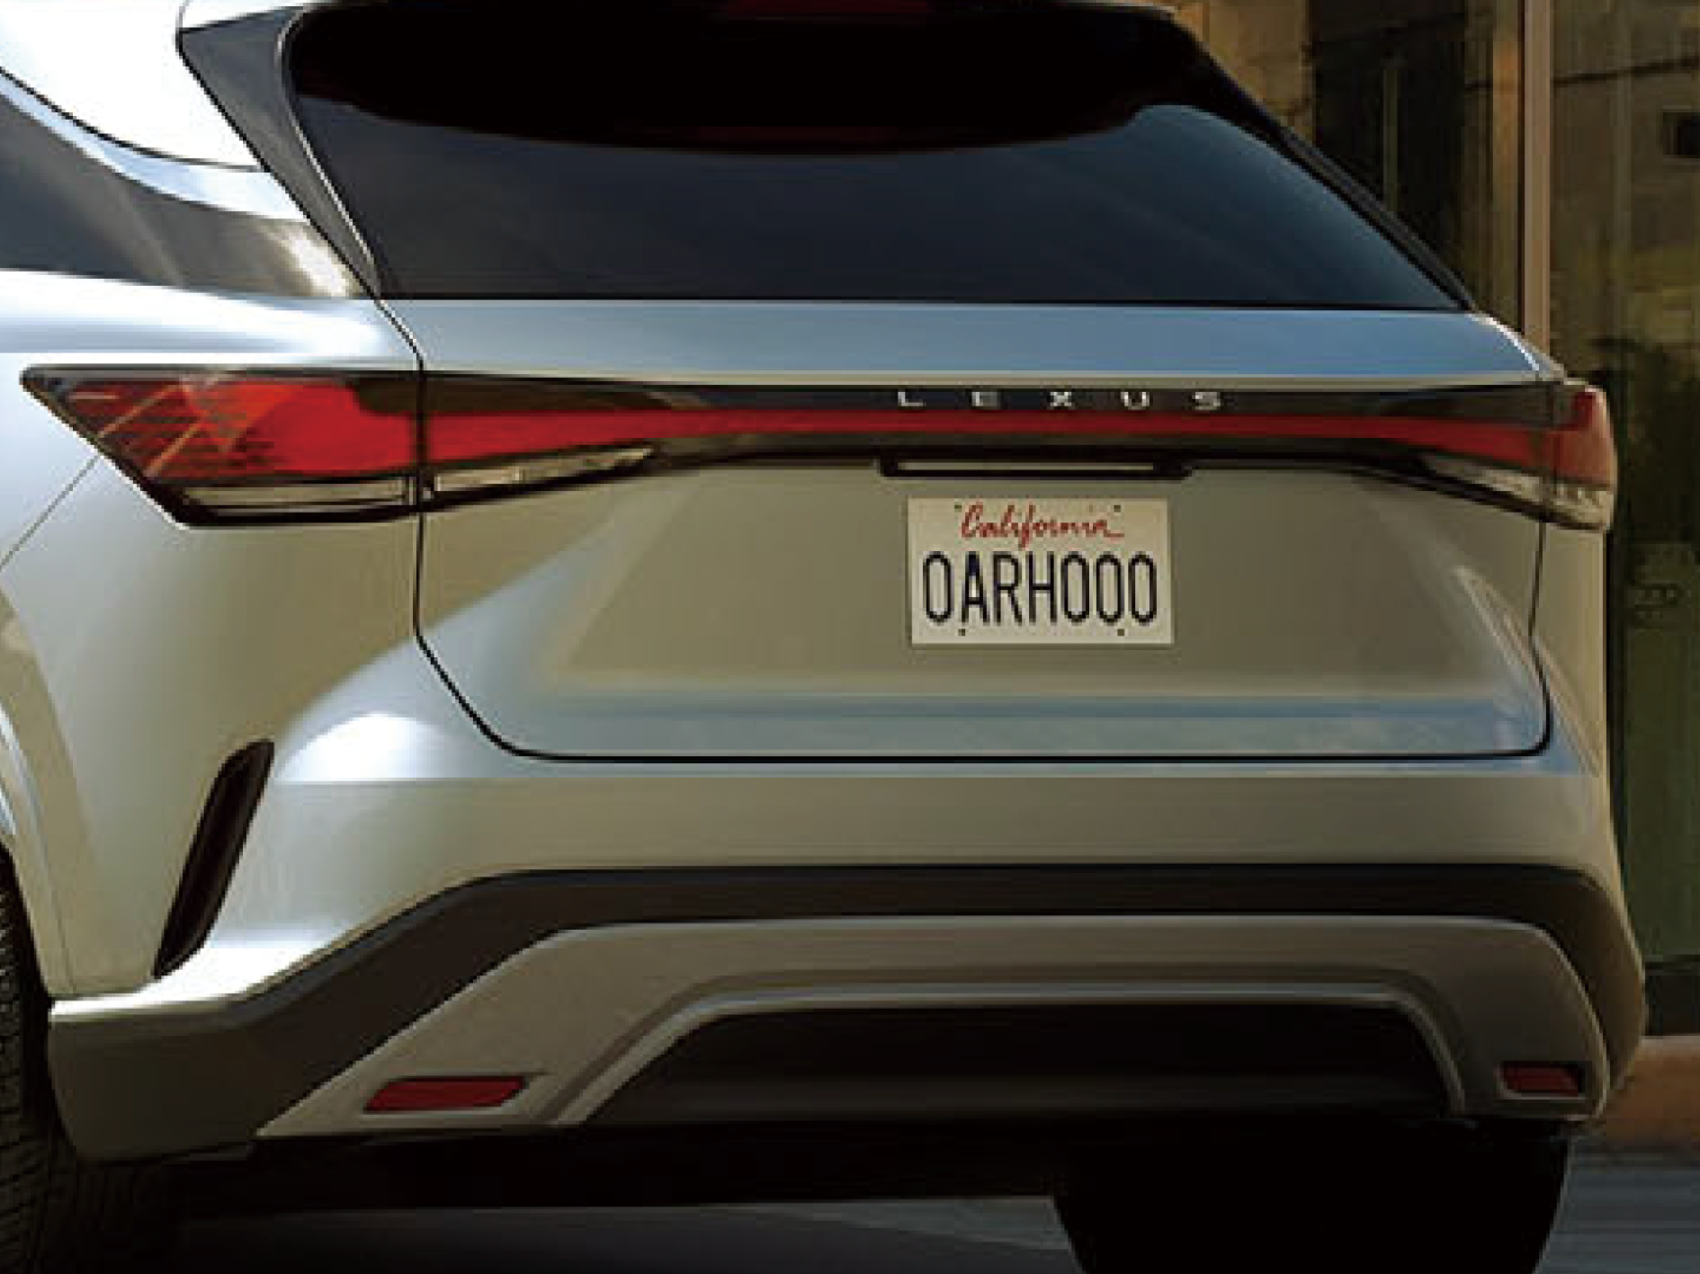
PRODUCT PRESENTATION
WHAT IS THE 5-POSITIONS WALKAROUND PRESENTATION?
Position 3 – Behind the vehicle (rear end)
Rear Styling, trunk space, rear functionality
Lead off with an impact statement
Start at the top, work your way down and say what you see
Hands-free liftgate
Cargo capacity
ParkView Rear Back-Up Camera
Towing capability

Slide 25
PRODUCT PRESENTATION
WHAT IS THE 5-POSITIONS WALKAROUND PRESENTATION?
Position 4 – Driver’s Side
The “big story”
All Safety features
Passive and Active
Performance and capability
Off-Road
Racing
Family Space

Slide 26
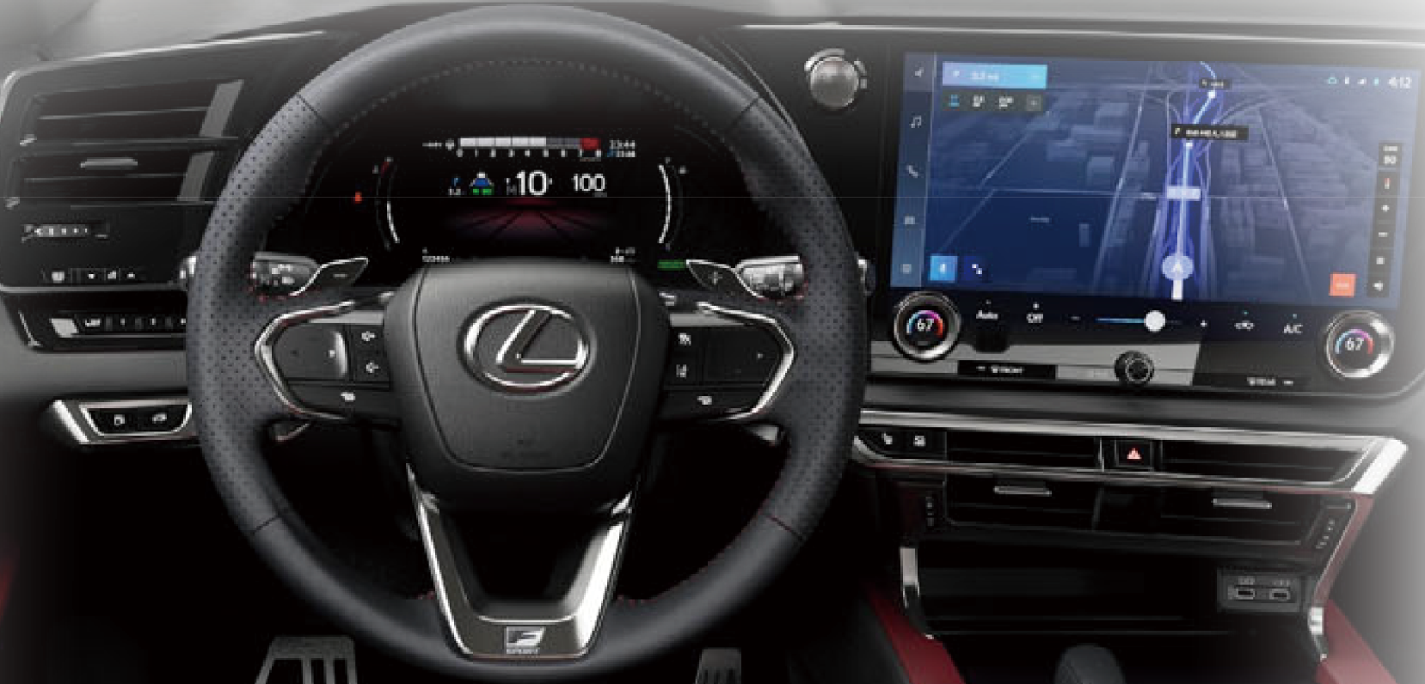
PRODUCT PRESENTATION
WHAT IS THE 5-POSITIONS WALKAROUND PRESENTATION?
Position 5 – Interior
Passenger front and rear seating, comfort and convenience
Power seats that adjust for optimal comfort
Folding seats
Storage area inside the vehicle
Infotainment technology, passive safety, steering wheel controls
Interior Styling and Luxury
Start with the sunroof (if equipped) and work down the center stack

Slide 27
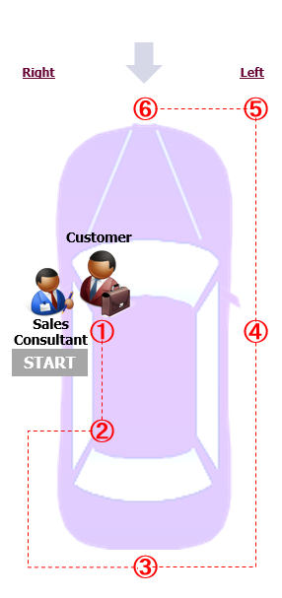
PRODUCT PRESENTATION
WHAT IS THE WALKAROUND PRESENTATION?
Approaching the car
Approach the car from the front for maximum impact
Opening Statement; Brand identity
Notes:
For Honda Population as per OEM standard 6 step walkaround presentation

Slide 28
PRODUCT PRESENTATION
WHAT IS THE 6-POSITIONS WALKAROUND PRESENTATION?
Position 1 – Interior Front
Passenger front seating, comfort and convenience
Power seats that adjust for optimal comfort
Storage area inside the vehicle
Infotainment technology, passive safety, steering wheel controls
Interior Styling and Luxury
Start with the sunroof (if equipped) and work down the center stack
Notes:
For Honda Population as per OEM standard 6 step walkaround presentation

Slide 29
PRODUCT PRESENTATION
WHAT IS THE 6-POSITIONS WALKAROUND PRESENTATION?
Position 2 – Interior Back
Passenger rear seating legroom, comfort and convenience
Folding seats
Storage area inside the vehicle
Infotainment technology
Interior Styling and Luxury
Visibility, rear headrests, seat belts, ISO fix
Notes:
For Honda Population as per OEM standard 6 step walkaround presentation

Slide 30
PRODUCT PRESENTATION
WHAT IS THE 6-POSITIONS WALKAROUND PRESENTATION?
Position 3 – Behind the vehicle (rear end)
Rear Styling, trunk space, rear functionality
Lead off with an impact statement
Start at the top, work your way down and say what you see
Hands-free liftgate
Cargo capacity
ParkView Rear Back-Up Camera
Towing capability
Notes:
For Honda Population as per OEM standard 6 step walkaround presentation

Slide 31
PRODUCT PRESENTATION
WHAT IS THE 6-POSITIONS WALKAROUND PRESENTATION?
Position 4 – Side
Side Styling
Suspension and wheels
Brakes
Suspension
Drivetrain
Ground clearance
Door handles, smart entry
Glass tinting, UV protection
Notes:
For Honda Population as per OEM standard 6 step walkaround presentation

Slide 32
PRODUCT PRESENTATION
WHAT IS THE 6-POSITIONS WALKAROUND PRESENTATION?
Position 5 – Side Angle Front
Headlight design
Fog lights, air intakes
Bonnet lines & sculpting
Visibility from driver's seat (high seating position, pillar visibility)
Notes:
For Honda Population as per OEM standard 6 step walkaround presentation

Slide 33
PRODUCT PRESENTATION
WHAT IS THE 6-POSITIONS WALKAROUND PRESENTATION?
Position 6 – Front of the vehicle
Front Styling / Aerodynamics
Lighting
Engines
Transmissions
Radar sensors, front camera
Notes:
For Honda Population as per OEM standard 6 step walkaround presentation

Slide 34
ACTIVITY: VEHICLE PRESENTATION WITH SPECIT
Mr. Hamad is interested in the brand vehicle used in the previous exercise. Use your SPECIT board from previous activity and 6-steps walkaround to present a vehicle and its features to Mr. Hamad. The trainer will play the role of Mr. Hamad – Groups not roleplaying to observe
Remain in the same groups as previous activity
20 minutes
Notes:
Groups of three

Slide 35

PRODUCT PRESENTATION
A GREAT TAILORED WALKAROUND PRESENTATION
Tailored to SPECIT motivations
Interactive and conversational
Uses a Feature-Function-Benefit-Advantage strategy
Use a five-point tailored walkaround presentation
Sell the value of the test drive

Slide 36
PRODUCT PRESENTATION
A GREAT TAILORED WALKAROUND PRESENTATION
Tailored to SPECIT motivations
Interactive and conversational
Uses a Feature-Function-Benefit-Advantage strategy
Use a six-point tailored walkaround presentation
Sell the value of the test drive

Slide 37
PRODUCT PRESENTATION
HOW DO YOU KEEP CUSTOMERS ACTIVELY INVOLVED?
Ask a lot of “what” questions…
“What is your opinion of…”
“What has been your experience with…”
“What would you do with…”
Invite the customer to operate, touch and feel features

Slide 38
HOW DO YOU MAKE PEOPLE WANT YOUR CARS?
FFBA

Slide 39
FFBA
WHAT IS FFBA?
Feature:
What it is?
Function:
What it does/how it works in wording the customer will understand?
Benefit:
Why is it important?
How it adds personal value?
How does it addresses a customer need or want?
Advantage:
What are the differences of the feature versus..?
How is it better than a similar feature on other products?

Slide 40
PRODUCT PRESENTATION
HOW TO USE FFBA?
Example
Feature:
Side blind zone alert
Function:
It detects any vehicle in the driver’s blind zone, and will alert the driver through a flashing signal in the side mirrors
Benefit:
This feature will help drivers in preventing accidents while changing lanes
Advantage:
You will find this on all grades here at BYD but not on all Tesla grades

Slide 41
FEATURE FUNCTION BENEFIT ADVANTAGE
FEATURES ARE ONLY USEFUL IF THEY RELATE TO THE CUSTOMERS NEEDS AND WANTS
Feature | Function | Benefit | Advantage
What the product/service has | What it does | Why it matters to the customer | Why it’s better than alternative/ competitor

Slide 42
FEATURE FUNCTION BENEFIT ADVANTAGE
FFBA STRATEGY: LOCKING DIFFERENTIAL – JEEP WRANGLER RUBICON
Feature | Function | Benefit | Advantage
Electronic locking differentials (front and rear) | Mechanically locks both wheels on an axle to rotate at the same speed | Maximizes traction in extreme off-road conditions like rock crawling or deep sand | Outperforms open or limited-slip differentials by ensuring power is delivered equally to both wheels, even if one is off the ground
Driver-selectable engagement | Allows the driver to activate the lockers manually when needed | Full control over traction management based on terrain | More precise and responsive than automatic systems that may lag or misjudge terrain
Integrated with Off-Road+ mode | Syncs with throttle, transmission, and traction settings for optimized off-road performance | Simplifies complex terrain handling with one-touch configuration | Competitive edge in user-friendly off-road capability compared to aftermarket systems
Heavy-duty Dana 44 axles | Built to withstand the stress of locked differential torque loads | Enhances durability and reliability in rugged environments | Reduces risk of drivetrain failure under extreme conditions, unlike lighter-duty alternatives

Slide 43
ACTIVITY 1: FFBA
Using the FFBA board provide three examples of FFBA based on the product chosen earlier - internet can be used to research advantages versus a competitor model.
In Pairs
15 minutes
Notes:
Groups of three

Slide 44
ACTIVITY: VEHICLE PRESENTATION WITH SPECIT
Mr. Hamad is interested in the brand vehicle. Use your SPECIT board from previous activity, FFBA and 5-steps walkaround to present a vehicle and its features to Mr. Hamad. The trainer will play the role of Mr. Hamad – Groups not roleplaying to observe
Remain in the same groups as previous activity
20 minutes
Notes:
Groups of three

Slide 45
4
SECTION
THE EXCEPTIONAL TEST DRIVE

Slide 46
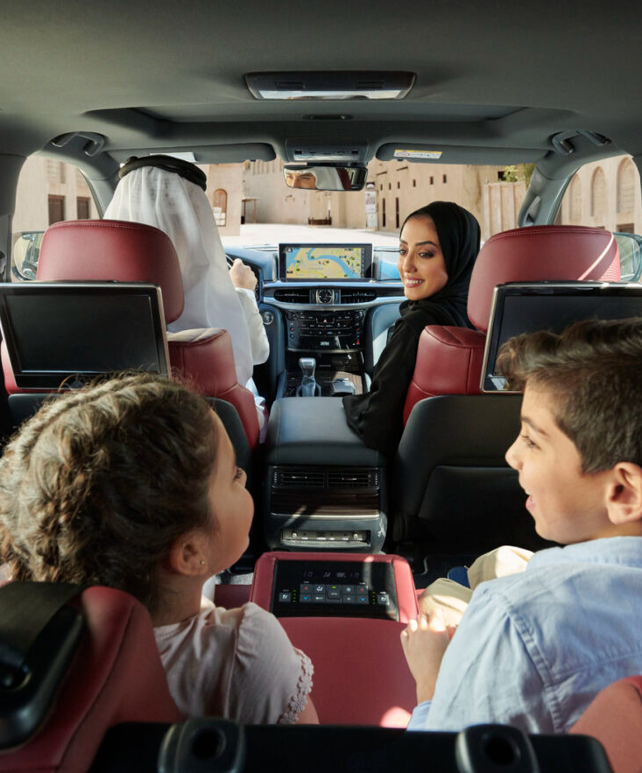
THE EXCEPTIONAL TEST DRIVE
WHY TEST-DRIVE?
Prove claims made in the Walkaround Presentation are true
Allow the customer to experience the vehicle for themselves
Allow customers to take “emotional ownership” of the vehicle
Answer all the customer’s questions about the vehicle and its features

Slide 47
THE EXCEPTIONAL TEST DRIVE
WHAT ARE THE BASICS OF AN EFFECTIVE TEST DRIVE?
Plan route based on customer use of the vehicle
Select routes that highlight vehicle features of interest
Help the customer prepare to drive:
Adjust seating, mirrors, seat belts, climate control and audio before drive
Reiterate key features, but don’t overdo it
Listen and observe customer reactions

Slide 48
THE EXCEPTIONAL TEST DRIVE
Remember
WHAT NOT TO DO DURING A TEST DRIVE:
Not knowing answers to product questions
Rushing through the test drive
Test driving a dirty or imperfect vehicle
Talking too much during the test drive

Slide 49
THE EXCEPTIONAL TEST DRIVE
HOW TO PERFORM THE TEST-DRIVE?
Prepare
Vehicle is Clean (Inside & Outside)
The route is set
Vehicle is ready to drive
You know what features to stress on
Documentations done
Drive
Switch
Feedback

Slide 50
THE EXCEPTIONAL TEST DRIVE
HOW TO PERFORM THE TEST-DRIVE?
Prepare
Start the test drive by driving the car and the customer in the passenger seat
Describe the route and why you chose it
Show the customer how all or most of the features are working
Answer any questions
Drive
Switch
Feedback

Slide 51
THE EXCEPTIONAL TEST DRIVE
HOW TO PERFORM THE TEST-DRIVE?
Prepare
Switch places and let the customer drive
DO NOT TALK or describe any further feature
Let the customer enjoy the drive silently
ONLY answer the customer’s questions
Drive
Switch
Feedback

Slide 52
THE EXCEPTIONAL TEST DRIVE
HOW TO PERFORM THE TEST-DRIVE?
Prepare
Well, looks like you have found your next car, right?
So, was it everything you were looking for in your next car or anything missing?
So, are we ready to move forward?
Let's go inside and talk, if we have right the car for you.
Are you ready to go inside and work about the details so you can take it home as soon as possible?
Drive
Switch
Feedback

Slide 53

WELCOME BACK
NEGOTIATION & CLOSING
MODULE 4

Slide 54
PROGRESSING THROUGH THE SALES PROCESS
Prospecting & Welcome
Qualification
Presentation & Demonstration
Negotiation & Closing
Great Deliveries
Follow Up & Retention
Notes:
Before explaining the customer journey, it is important to remember that there are two sides to the Purchase of a car. We are only looking at one side when we look at the sales process. The other side is the customer Buying Process.
A person doesn’t just decide on a whim to go and buy a car. Something will instigate that decision. It could be an advert on TV or the internet. It could be a neighbor or friend getting a new car. It could be something as simple as their old car getting too expensive to keep on the road. Whatever it is, it is this trigger that will start them on the journey that will lead to them purchasing a car.
From our point of view, the earlier we can get involved in the buying process the more successful we are likely to be in selling them their new car.
It is important to understand and be aware of where the customer is on the buying process. If we try to sell to them before they are ready, our chance s of success drop dramatically.
So what is involved in a customer buying process
DO:
Open this to a general discussion then show them the Buying process

Slide 55
1
SECTION
SALES QUOTATION

Slide 56

SALES QUOTATION BEST PRACTISE
When should we present our quote?
Following Successful Product Presentation
Following Successful Product Demonstration
Following a clear buying signal
Following a positive trial close response
Where should we present our quote?
Professional Environment
Showroom Office/Desk
Private Space (Mall/Pop-up)
Corporate Office (B2B)
Alongside the customer if comfortable
M/S Teams where face-to-face is not possible
Notes:
“When we present the quote, the goal is to make the customer feel that we’re working with them, not against them. That’s why we ideally do it in a professional setting — at our showroom desk, a private area, or even a corporate office for B2B clients.
In some cases, if the customer feels comfortable, we can sit alongside them rather than across the desk. This creates a more collaborative atmosphere — it feels like we’re reviewing the details together and being transparent.
Of course, this depends on the customer’s comfort level and personal space, so we should always read their body language before doing so. The key idea is to build trust and make the discussion feel open and supportive.”

Slide 57

SALES QUOTATION BEST PRACTISE CONTINUED…
How should we present our quote?
Ensuring the customer is comfortable
When you have the customers full attention
Explaining the quote from bottom to top
Pointing at the section you are explaining
Clearly & confidently
Body language & Tone of voice
Focusing on all decision makers present
Verifying details are correct
Highlight meaningful details (e.g.. accessories/options)
Gaining Approval Throughout (Verbal Nods)
In Collaboration with Management (when appropriate)
Notes:
When we present the quote, we always explain it from bottom to top — meaning we start with the final amount first, then move upward to explain what’s included and how that total is built. This approach shows confidence, avoids the ‘price build-up’ effect that can make customers uncomfortable, and allows us to justify the value straight away. We’re not hiding the cost — we’re showing the customer exactly what they’re paying for, in a transparent and professional way.

Slide 58
SALES QUOTATION
Remember
THERE IS NO ONE SIZE FITS ALL!
The sales quotation must be TAILORED for each customer.
Use your rapport building and qualification to present a sales quotation based on individual customer personality types, needs and buying motives you have established.

Slide 59
2
SECTION
NEGOTIATION

Slide 60

WHAT IS THE DEFINITION OF “NEGOTIATION”?
Formal discussions between people who have different aims or intentions, especially in business or politics, during which they try to reach an agreement.
Conference and bargaining for a mutually agreeable solution.

Slide 61
WHAT ARE THE DIFFERENT OUTCOMES OF NEGOTIATION?
HIGH
LOSE / WIN
WIN / WIN
Consideration
LOSE / LOSE
WIN / LOSE
LOW
Courage
HIGH
Notes:
In negotiation, two things matter — courage and consideration. Courage is about standing up for our offer, our price, and our value. Consideration is about understanding the customer’s situation and priorities.
When both are high, we achieve a win–win — a balanced outcome where both parties are satisfied and trust is strengthened. If we lower either one, we risk losing the deal or the relationship. So the best negotiators manage both — they’re confident, but also empathetic.
Consideration and Courage
Consideration means how much you value and respect the other person’s needs, relationship, and interests.
Courage means how much you stand up for your own needs, goals, and limits.
Every negotiator has different levels of both — and that’s what creates different outcomes.
Then describe each briefly:
Low Courage / Low Consideration (Lose–Lose): No one stands up for themselves or values the other side — both lose; the deal fails or both walk away unhappy.
Low Courage / High Consideration (Lose–Win): You give in to keep the relationship — customer wins, you lose; might seem polite, but it’s unsustainable.
High Courage / Low Consideration (Win–Lose): You push too hard to get your way — you might win the deal, but damage trust or lose long-term loyalty.
High Courage / High Consideration (Win–Win): You’re firm but fair — you express your needs confidently while respecting the customer’s priorities, finding a balance that satisfies both sides.
The win–win approach means being clear, confident, and caring at the same time. We maintain high courage by knowing the value of our product and what we can offer, and we maintain high consideration by truly listening to the customer’s needs, budget, and expectations.
We don’t try to ‘beat’ the customer — we aim to create mutual value. That’s how trust is built and long-term relationships grow. It’s not about who wins the negotiation, it’s about both sides walking away feeling they made a good decision.

Slide 62

TOP TIPS WHEN NEGOTIATING
Be confident
Have a negotiation strategy
Quote your price, then be quiet!
Seek a win/win outcome
Customer feels positive about the deal
Value yourself, your time & your product
Negotiate at the right time & place
Only enter into negotiation if instigated by the customer
Answer questions promptly with confidence
Notes:
KEY POINTS
The ideal outcome of negotiation is one where both parties feel like they have a good deal – the prospect of long a term-relationship and referrals is high.
In order to stop negotiation being solely about price, we should consider the ‘tradeables’ we and the customer have to offer.
In order to negotiate effectively you should be prepared with a strategy, have confidence, value yourself and the product and only enter negotiation after you have been through the process of needs based selling.

Slide 63
WHEN NEGOTIATING WHAT THINGS COULD BE USED AS “TRADEABLES”?
Vehicle Options/ Grade
Service Plans
Referrals / Loyalty
Re-sale value*
Accessories
Extended Warranty
Finance Options/ Term / Drive on Lease
Event Tickets / VIP access
FAB Credit Card / Blue Rewards

Slide 64
6
SECTION
OBJECTION HANDLING

Slide 65

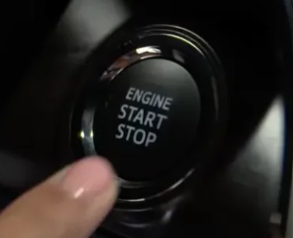
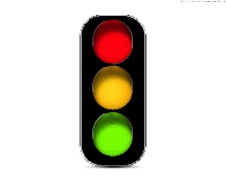
NAVIGATING OBJECTIONS – THE SALES JOURNEY
SUCCESS?
Notes:
KEY POINTS
The ideal outcome of negotiation is one where both parties feel like they have a good deal – the prospect of long a term-relationship and referrals is high.
In order to stop negotiation being solely about price, we should consider the ‘tradeables’ we and the customer have to offer.
In order to negotiate effectively you should be prepared with a strategy, have confidence, value yourself and the product and only enter negotiation after you have been through the process of needs based selling.

Slide 66
OBJECTION HANDLING
Remember
ALWAYS BE OBJECTION ALERT!
Objections are unique to the customer based on their experience and understanding.
Use your rapport building to positively win over the customer. Use your product knowledge to explain and demonstrate features to reassure them and add additional value before moving on.

Slide 67
THE 6 GOLDEN RULES
Don’t argue with it
Don’t agree with it
Don’t ignore it
Don’t sell to it…yet
Don’t give up
Don’t take it at face value
Notes:
KEY POINTS
The ideal outcome of negotiation is one where both parties feel like they have a good deal – the prospect of long a term-relationship and referrals is high.
In order to stop negotiation being solely about price, we should consider the ‘tradeables’ we and the customer have to offer.
In order to negotiate effectively you should be prepared with a strategy, have confidence, value yourself and the product and only enter negotiation after you have been through the process of needs based selling.

Slide 68
OBJECTION HANDLING
APAC Objection Handling Framework
Step | Description | Purpose | Example
Acknowledge | Recognize the objection without arguing or dismissing it. | Builds trust and shows empathy. | “I understand why that might be a concern.”
Probe | Ask clarifying questions to uncover the root cause of the objection. | Helps you understand the real issue behind the objection. | “Can you tell me more about what specifically worries you about the cost?”
Answer | Address the objection with relevant facts, benefits, or solutions. | Resolves the concern with tailored information. | “Actually, the total cost includes post-sale support and free upgrades for 2 years.”
Confirm | Check if the objection has been resolved and move forward. | Ensures alignment and readiness to proceed. | “Does that address your concern? Can we move to the next step?”

Slide 69
7
SECTION
CLOSING & TRIAL CLOSING

Slide 70

WHAT IS THE DIFFERENCE BETWEEN A TRIAL CLOSE & A FINAL CLOSE?
Trial Close
Testing the water, gaining a commitment to progress to the next stage, used throughout the process.
Often referred too as a “Buying Signal”
Final Close
Securing overall commitment, used at the end of the process.
BUY
Notes:
KEY POINTS
The ideal outcome of negotiation is one where both parties feel like they have a good deal – the prospect of long a term-relationship and referrals is high.
In order to stop negotiation being solely about price, we should consider the ‘tradeables’ we and the customer have to offer.
In order to negotiate effectively you should be prepared with a strategy, have confidence, value yourself and the product and only enter negotiation after you have been through the process of needs based selling.

Slide 71
FINAL CLOSE EXAMPLES
Direct Close
A direct question
“Are you happy to go ahead?”
Assumptive Close
Acting as though the deal is already done.
“So you’d like it in Victory Pearl White then?”
Alternative Close
Like the assumptive, but with a choice.
“Would you like it in Hydro Blue or Granite Crystal?”
Notes:
KEY POINTS
The ideal outcome of negotiation is one where both parties feel like they have a good deal – the prospect of long a term-relationship and referrals is high.
In order to stop negotiation being solely about price, we should consider the ‘tradeables’ we and the customer have to offer.
In order to negotiate effectively you should be prepared with a strategy, have confidence, value yourself and the product and only enter negotiation after you have been through the process of needs based selling.

Slide 72
FINAL CLOSE EXAMPLES CONTINUED….
1,2,3 Close
Summarise the value / benefits in sets of 3…
“I can get you the X model, with JBL audio, the 21” wheels and the Platinum paint for X-AED are you happy to go ahead?”
Yes Close
Pull on the trial closes to get them to say “YES” 3 times…
“You need the car by the 20th next month? You liked the model I showed you? You want it with the side steps, right? Great, if I can get you all of this will you be happy to buy?”
No Hassle Close
Taking all the hassle away from the customer…
Take a seat, I’ll get you another coffee, ill print this order with everything you’ve told me you want all you need to do is sign here…
Notes:
KEY POINTS
The ideal outcome of negotiation is one where both parties feel like they have a good deal – the prospect of long a term-relationship and referrals is high.
In order to stop negotiation being solely about price, we should consider the ‘tradeables’ we and the customer have to offer.
In order to negotiate effectively you should be prepared with a strategy, have confidence, value yourself and the product and only enter negotiation after you have been through the process of needs based selling.

Slide 73
REMEMBER!
CLOSING IS ALL ABOUT CUSTOMER TYPES
Final closing styles should vary from customer to customer.
Use your knowledge of the customer created through rapport building to identify which style of close will be most positively received and therefor most likely to generate a WIN/WIN outcome .

Slide 74


CONCLUSION
In today’s session we have discussed…
The importance of the presentation and demonstration step for the sales process
How to present the vehicle to a customer using;
5-steps walkaround
SPECIT
FFBA
How to perform and exceptional test drive
Techniques for negotiation mindset
Different styles of final closing

Slide 75
CONCLUSION
In today’s session we have discussed…
The importance of the presentation and demonstration step for the sales process
How to present the vehicle to a customer using;
6-steps walkaround
SPECIT
FFBA
How to perform and exceptional test drive
Techniques for negotiation mindset
Different styles of final closing

Slide 76
QUESTIONS

Slide 77
YOUR SALES GROWTH JOURNEY – NEXT STEPS...
First Gear - Sales Induction & Probation
IMI Sales Process Module 1 & 2
IMI Sales Process Module 3 & 4
Product eLearning
IMI Sales Process Module 5 (Half day)
On the job training
Advanced Customer Communications
Coaching 1-2-1’s
IMI Sales Accreditation Assessment (In-Branch)
IMI Sales Accreditation Awards Ceremony

Slide 78
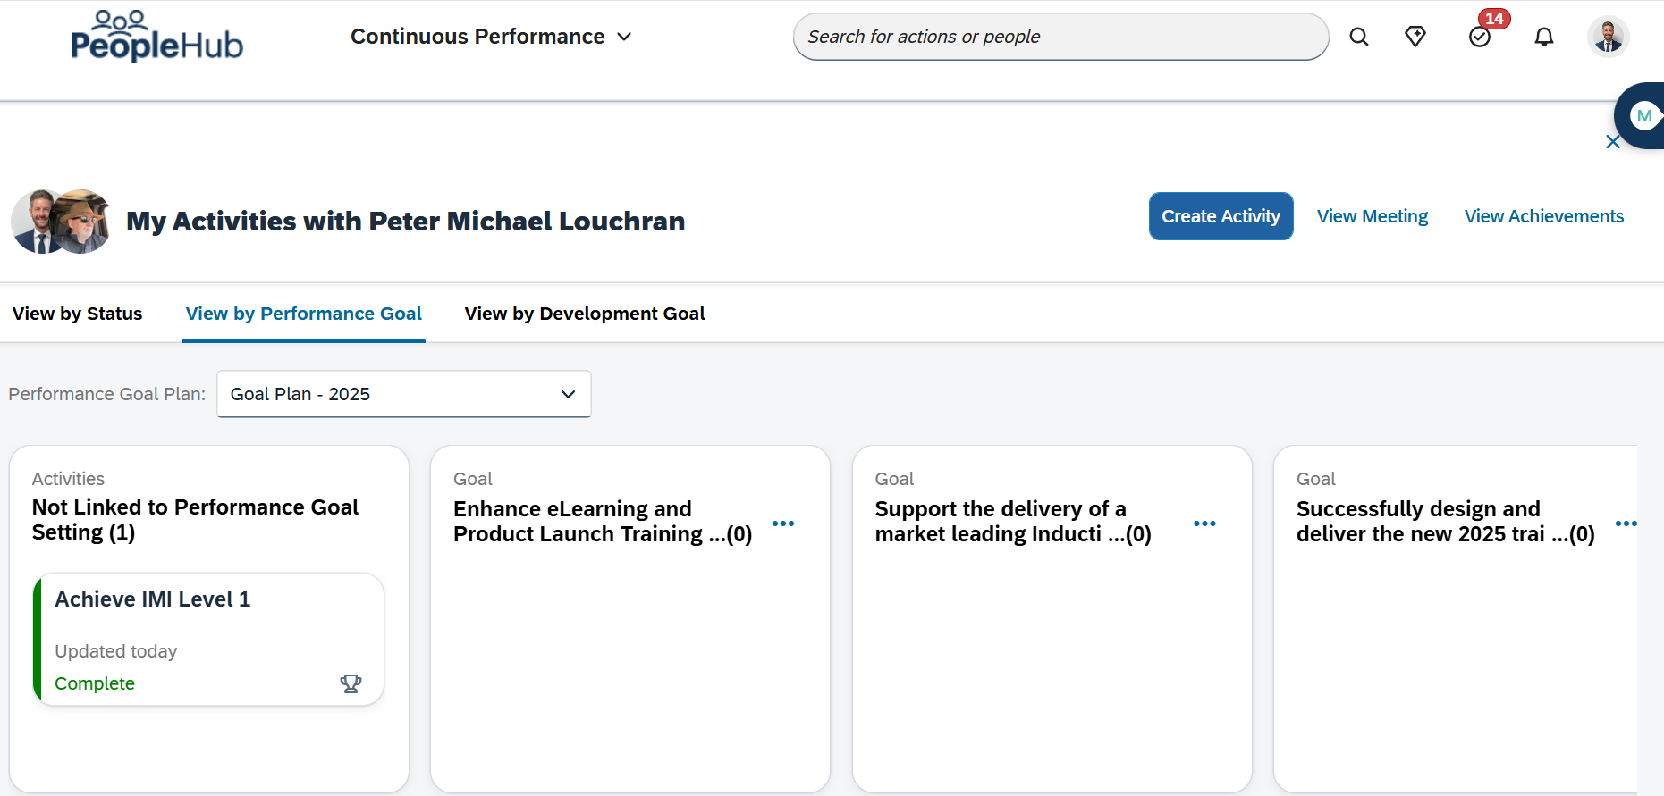
NEXT STEPS – HAVE YOU SET AN IDP?

Slide 79
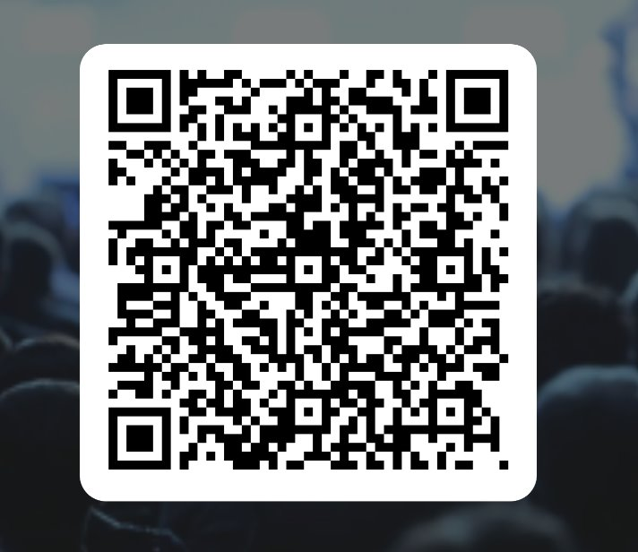
THANK YOU!
Sales Process Module 3 & 4 | FEEDBACK
Please scan the QR code below to share your feedback

